Slide 1
Discussion 9: Tree Traversals, Tries, K-D Trees
Christine Zhou

Slide 2
Agenda
K-D Tree review (with demos from lecture)
K-D Tree problems
Tree Traversal review
Tree Traversal problems
Trie review
Trie problems

Slide 3
Announcements
Project 2B is due on Saturday, March 23 at 11:59pm. Remember that these are real deadlines (not "checkpoints")
Check out Hug’s updated kd-tree nearest video @3426
Midterm 2 is on April 5th from 8-10pm. Here are some events to keep on your radar!
Course Staff Guerrilla Section - 3/31 12-2PM Soda Labs
HKN Review Session - 3/31 3-6PM HP Auditorium
CSM Review Session - 4/1 6-9PM HP Auditorium
Discussion survey: tinyurl.com/cz-disc9-sp19

Slide 4
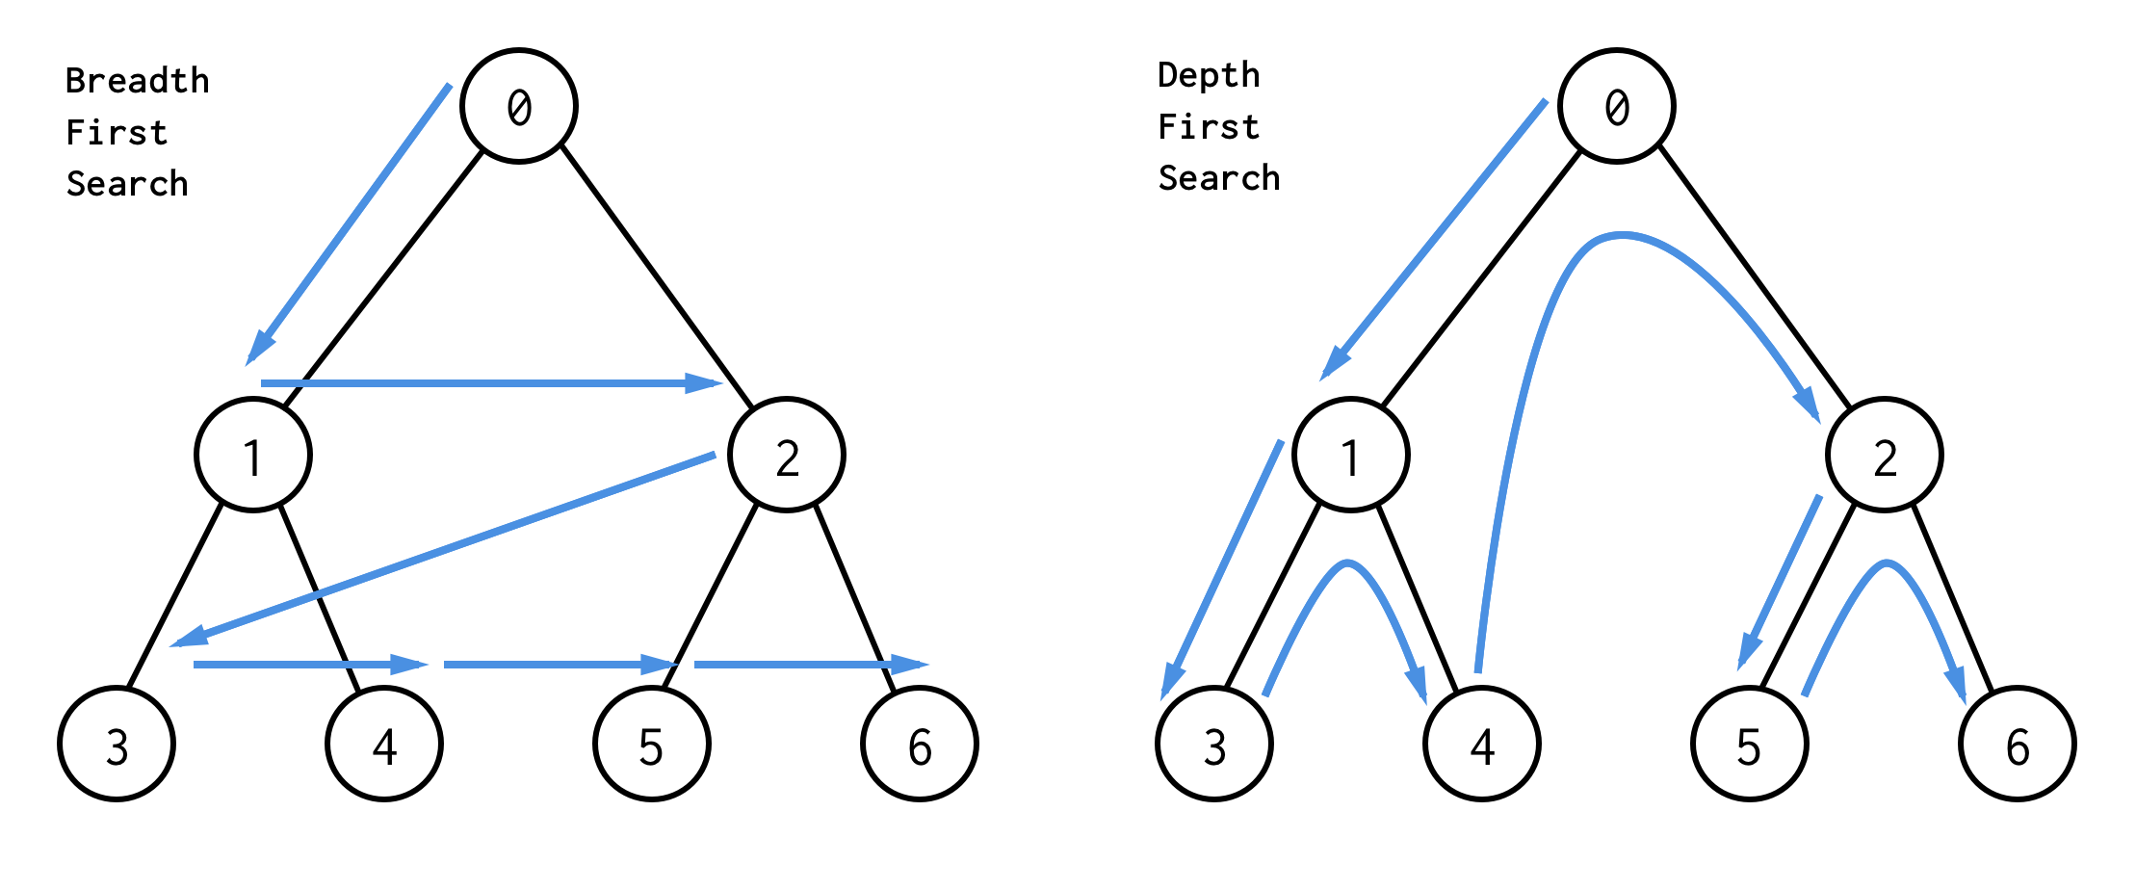
Tree Traversals
Level-Order/Breadth First Search (BFS):
Visit top to bottom, left to right, just like how you read!
Depth-order/Depth First Search (DFS):
Traverse “deeper” nodes before shallow ones

Slide 5
Types of DFS: Preorder
Pre-Order: “Visit” a node, then traverse its children
preOrder(BSTNode x) {
if (x == null) return; print(x.key) preOrder(x.left) preOrder(x.right) }
Hack: draw “pegs” on the left side of each node and take a walk around the edges of the tree. The Preorder is the order in which you hit the pegs
D
B
F
A
C
E
G
Pre-Order: DBACFEG

Slide 6
Types of DFS: Inorder
In-Order: Traverse left child, “visit” node, then traverse right child
inOrder(BSTNode x) {
if (x == null) return; inOrder(x.left) print(x.key)
inOrder(x.right) }
Hack: draw “pegs” on the bottom of each node and take a walk around the edges of the tree. The Inorder is the order in which you hit the pegs
D
B
F
A
C
E
G
In-Order: ABCDEFG

Slide 7
Types of DFS: Postorder
Post-Order: Traverse children, then “visit” node.
postOrder(BSTNode x) {
if (x == null) return; postOrder(x.left)
postOrder(x.right) print(x.key)
}
Hack: draw “pegs” on the right side of each node and take a walk around the edges of the tree. The postorder is the order in which you hit the pegs
D
B
F
Post-Order: ACBEGFD
A
C
E
G

Slide 8
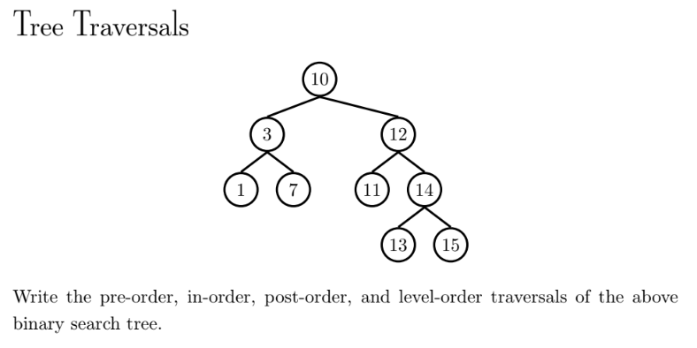
Problem 1.1

Slide 9
Solution
Pre-Order: 10, 3, 1, 7, 12, 11, 14, 13, 15
In-Order: 1, 3, 7, 10, 11, 12, 13, 14, 15
Post-Order: 1, 7, 3, 11, 13, 15, 14, 12, 10
Level-Order: 10, 3, 12, 1, 7, 11, 14, 13, 15
Notes:
The numbers for the in-order traversal are in increasing order! Note that in-order traversal doesn’t always give us a list of numbers in order - it depends on the tree given.

Slide 10
Tries
Each node holds a single character
Special flag for end-of-word node
boolean end = True;
Shown in diagram as blue nodes
ensures that trie.contains(a) is True, and that trie.contains(aw) is False
What words does the Trie on the right contain?
a
s
w
a
l
d
m
p
s
e

Slide 11
Tries
Each node holds a single character
Special flag for end-of-word node
boolean end = True;
Shown in diagram as blue nodes
ensures that trie.contains(a) is True, and that trie.contains(aw) is False
What words does the Trie on the right contain?
A: a, awls, sam, sad, sap, same
a
s
w
a
l
d
m
p
s
e

Slide 12
Runtime of Tries
By now, analyzing runtimes of algorithms and data structures should be a habit.
Runtimes treating length of keys as a constant
 | key type | get(x) | add(x)
Balanced BST | comparable | Θ(log N) | Θ(log N)
Resizing separate chaining Hash Table | hashable | Θ(1)† | Θ(1)*†
data indexed array | chars | Θ(1) | Θ(1)
Tries (Data Indexed Char Map) | Strings | Θ(1) | Θ(1)
*: Indicates “on average”.
†: Assuming items are evenly spread.

Slide 13
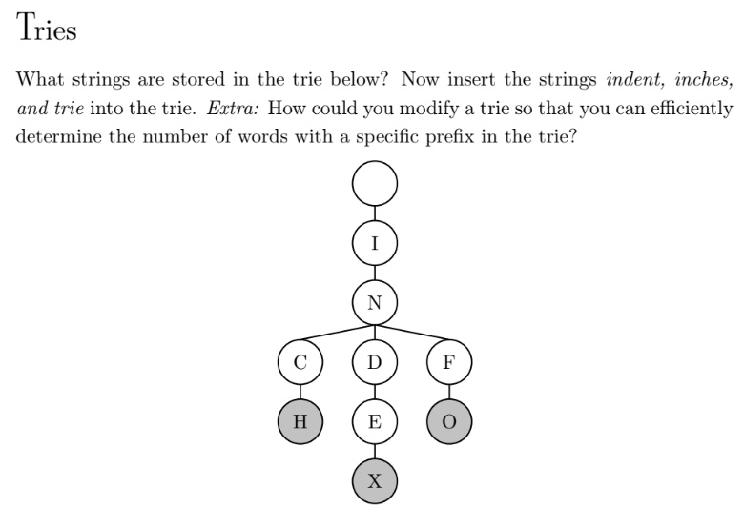
Problem 2.1

Slide 14
Solutions
I
It contains the words Inch, Index, Info
N
C
D
F
H
E
O
X

Slide 15
Solutions
I
insert “indent”
N
C
D
F
H
E
O
N
X

Slide 16
Solutions
I
insert “indent”
t is the end (that’s why it’s brown)
N
C
D
F
H
E
O
N
X
T

Slide 17
Solutions
I
insert “inches”
N
C
D
F
H
E
O
E
N
X
T

Slide 18
Solutions
I
insert “inches”
s is the end (that’s why it’s brown)
N
C
D
F
H
E
O
E
N
X
S
T

Slide 19
Solutions
I
T
insert “tries”
N
C
D
F
H
E
O
E
N
X
S
T

Slide 20
Solutions
I
T
insert “tries”
N
R
C
D
F
H
E
O
E
N
X
S
T

Slide 21
Solutions
I
T
insert “tries”
N
R
C
D
F
I
H
E
O
E
N
X
S
T

Slide 22
Solutions
I
T
insert “tries”
N
R
C
D
F
I
H
E
O
E
E
N
X
S
T

Slide 23
Solutions
I
T
insert “tries”
s is the end (that’s why it’s brown)
N
R
C
D
F
I
H
E
O
E
E
N
X
S
S
T

Slide 24
K-D Trees
K-D Trees are trees that hold points on a coordinate system.
It can be generalized to many dimensions, not just 2D
Sorted like a binary tree, with each level using a different dimension to partition
First level: X axis
Second level: Y axis
Third level: X axis
Etc
Insertion Demo
Find Nearest demo
(1, 5)
(4, 5)
E
C
(4, 4)
F
(3, 3)
A
D
(2, 3)
B
(4, 2)
Notes:
If students have already watched lecture, they are probably more familiar with the Insertion and Find Nearest demos, so you can skip those.
Feel free to give students another walk through, or wait until you go over 3.2

Slide 25
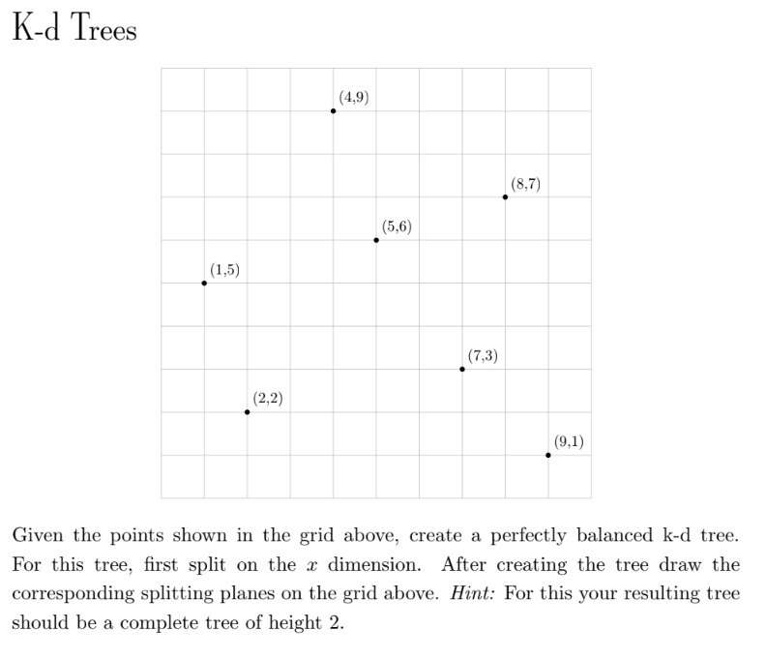
Problem 3.1

Slide 26
Problem 3.1
(5, 6)
L
R

Slide 27
(5, 6)
L
R
(1, 5)
(7, 3)
D
U
D
U

Slide 28
(5, 6)
L
R
(1, 5)
(7, 3)
D
U
D
U
(2, 2)
(4, 9)
(9, 1)
(8, 7)
L
L
R
R
L
L
R
R

Slide 29

Problem 3.2

Slide 30
Solution
(5, 6)
insert((6, 2))
6 is to the right of 5, so we traverse right on the root. 2 is lower than 3, so we traverse left. Then 6 is to the left of 9, so we traverse left once again and add the node there.
L
R
(1, 5)
(7, 3)
D
U
D
U
(2, 2)
(4, 9)
(9, 1)
(8, 7)
L
L
R
R
L
L
R
R
(6, 2)
D
U

Slide 31
Problem 3.3

Slide 32
Here’s the general idea
Psuedocode (on Slide 34)
Variables to track: bestGlobalDistance, bestGlobalPoint

Slide 33
Here’s the general idea
Psuedocode (on Slide 34)
Variables to track: bestGlobalDistance, bestGlobalPoint
When you reach a node, check its distance the goalPoint.
If it is better than bestGlobalDistance, update bGD and bGP.

Slide 34
Here’s the general idea
Psuedocode (on Slide 34)
Variables to track: bestGlobalDistance, bestGlobalPoint
When you reach a node, check its distance the goalPoint.
If it is better than bestGlobalDistance, update bGD and bGP.
Figure out the node’s goodBranch and badBranch

Slide 35
Here’s the general idea
Psuedocode (on Slide 34)
What is a goodBranch?
Just think about where you would go if you wanted to INSERT the goalPoint into the KDTree. That’s your goodBranch.
What is the badBranch?
The one that’s not the goodBranch. :D

Slide 36
Here’s the general idea
Psuedocode (on Slide 34)
Variables to track: bestGlobalDistance, bestGlobalPoint
When you reach a node, check its distance the goalPoint.
If it is better than bestGlobalDistance, update bGD and bGP.
Figure out the node’s goodBranch and badBranch
Visit your goodBranch. ALWAYS. NO MATTER WHAT.

Slide 37
Here’s the general idea
Psuedocode (on Slide 34)
Variables to track: bestGlobalDistance, bestGlobalPoint
When you reach a node, check its distance the goalPoint.
If it is better than bestGlobalDistance, update bGD and bGP.
Figure out the node’s goodBranch and badBranch
Visit your goodBranch. ALWAYS. NO MATTER WHAT.
Note: We are recursing here on step 3.

Slide 38
Here’s the general idea
Psuedocode (on Slide 34)
Variables to track: bestGlobalDistance, bestGlobalPoint
When you reach a node, check its distance the goalPoint.
If it is better than bestGlobalDistance, update bGD and bGP.
Figure out the node’s goodBranch and badBranch
Visit your goodBranch. ALWAYS. NO MATTER WHAT.
Note: We are recursing here on step 3.
Note: The recursive call might update bGD and bGP. This is not a problem, but just a note.

Slide 39
Here’s the general idea
Psuedocode (on Slide 34)
Variables to track: bestGlobalDistance, bestGlobalPoint
When you reach a node, check its distance the goalPoint.
If it is better than bestGlobalDistance, update bGD and bGP.
Figure out the node’s goodBranch and badBranch
Visit your goodBranch. ALWAYS. NO MATTER WHAT.
Note: We are recursing here on step 3.
Note: The recursive call might update bGD and bGP. This is not a problem, but just a note.
Decide whether or not to visit badBranch.

Slide 40
Here’s the general idea
Psuedocode (on Slide 34)
Variables to track: bestGlobalDistance, bestGlobalPoint
When you reach a node (called, say, currNode), check its distance the goalPoint.
If it is better than bestGlobalDistance, update bGD and bGP.
Figure out the node’s goodBranch and badBranch
Visit your goodBranch. ALWAYS. NO MATTER WHAT.
Note: We are recursing here on step 3.
Note: The recursive call might update bGD and bGP. This is not a problem, but just a note.
Decide whether or not to visit badBranch.
Hacky decision rule: Drop a perpendicular from goalPoint to line corr. to currNode.

Slide 41
Here’s the general idea
Psuedocode (on Slide 34)
Variables to track: bestGlobalDistance, bestGlobalPoint
When you reach a node (called, say, currNode), check its distance the goalPoint.
If it is better than bestGlobalDistance, update bGD and bGP.
Figure out the node’s goodBranch and badBranch
Visit your goodBranch. ALWAYS. NO MATTER WHAT.
Note: We are recursing here on step 3.
Note: The recursive call might update bGD and bGP. This is not a problem, but just a note.
Decide whether or not to visit badBranch.
Hacky decision rule: Drop a perpendicular from goalPoint to line corr. to currNode.
If the length of this perpendicular is shorter than bGD, visit badBranch (aka recurse on it starting from step 1)

Slide 42
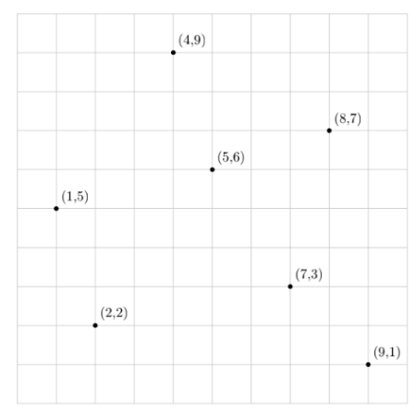
Solution
globalBestDistance: 2
globalBestPoint: (5, 6)
(5, 6)
L
R
(1, 5)
(7, 3)
D
U
D
U
(2, 2)
(4, 9)
(9, 1)
(8, 7)
L
L
R
R
L
L
R
R
(6, 2)
D
U
nearest((3, 6))
Start at root; the distance to (3, 6) from (5, 6) is 2. We set this as the globalBest. The x-coordinate of (3, 6) is smaller than our root’s (5,6). So goodBranch is LEFT.
Notes:
note that we use the sqrt((x_2-x_1) ** 2 + (y_2-y_1) ** 2) to calculate the distance

Slide 43
Solution
globalBestDistance: 2
globalBestPoint: (5, 6)
(5, 6)
L
R
(1, 5)
(7, 3)
D
U
D
U
(2, 2)
(4, 9)
(9, 1)
(8, 7)
L
L
R
R
L
L
R
R
(6, 2)
D
U
nearest((3, 6))
Start at root; the distance to (3, 6) from (5, 6) is 2. We set this as the globalBest. The x-coordinate of (3, 6) is smaller than our root’s (5,6). So goodBranch is LEFT. We ALWAYS go to goodBranch.
Notes:
note that we use the sqrt((x_2-x_1) ** 2 + (y_2-y_1) ** 2) to calculate the distance

Slide 44
Solution
globalBestDistance: 2
globalBestPoint: (5, 6)
(5, 6)
L
R
(1, 5)
(7, 3)
D
U
D
U
(2, 2)
(4, 9)
(9, 1)
(8, 7)
L
L
R
R
L
L
R
R
(6, 2)
D
U
The distance between (3, 6) and (1, 5) is 2.2, which is not smaller than our globalBest. Now we compare the y-coordinate of (3, 6) with (1, 5). Since 6 > 5, our goodBranch is RIGHT.
Notes:
note that we use the sqrt((x_2-x_1) ** 2 + (y_2-y_1) ** 2) to calculate the distance

Slide 45
Solution
globalBestDistance: 2
globalBestPoint: (5, 6)
(5, 6)
L
R
(1, 5)
(7, 3)
D
U
D
U
(2, 2)
(4, 9)
(9, 1)
(8, 7)
L
L
R
R
L
L
R
R
(6, 2)
D
U
Distance between (3, 6) and (4, 9) is 3.16, which is not less than globalBest. Now we compare the x-coordinate of (3, 6) with (4, 9). Since 3 < 4, we traverse the left side.
Notes:
note that we use the sqrt((x_2-x_1) ** 2 + (y_2-y_1) ** 2) to calculate the distance

Slide 46

Solution
globalBestDistance: 2
globalBestPoint: (5, 6)
(5, 6)
L
R
(1, 5)
(7, 3)
D
U
D
U
(2, 2)
(4, 9)
(9, 1)
(8, 7)
L
L
R
R
L
L
R
R
(6, 2)
D
U
Since the left child is null, we go back up to (4, 9).

Slide 47
Solution
globalBestDistance: 2
globalBestPoint: (5, 6)
(5, 6)
L
R
(1, 5)
(7, 3)
D
U
D
U
(2, 2)
(4, 9)
(9, 1)
(8, 7)
L
L
R
R
L
L
R
R
(6, 2)
D
U
Could the right child of (4,9) (badBranch) give us a better distance? To find out, we drop a perpendicular line on the grid from (3, 6) until it hits the box containing (4, 9), which gets us to the point (4, 6). The distance between (3, 6) and (4, 6) is 1, which is better than globalBest. We traverse this right child of (4, 9), hoping to get a smaller distance.
Notes:
the right child of (4, 9) is our bad branch

Slide 48
Solution
globalBestDistance: 2
globalBestPoint: (5, 6)
(5, 6)
(5, 6)
L
L
R
R
(1, 5)
(1, 5)
(7, 3)
(7, 3)
D
D
U
U
D
D
U
U
(2, 2)
(2, 2)
(4, 9)
(4, 9)
(9, 1)
(9, 1)
(8, 7)
(8, 7)
L
L
L
L
R
R
R
R
L
L
L
L
R
R
R
R
(6, 2)
D
U
Since the right child is null, we go back up to (4, 9).

Slide 49
Solution
globalBestDistance: 2
globalBestPoint: (5, 6)
(5, 6)
L
R
(1, 5)
(7, 3)
D
U
D
U
(2, 2)
(4, 9)
(9, 1)
(8, 7)
L
L
R
R
L
L
R
R
(6, 2)
D
U
Now that we’ve finished looking at the good branch (the (4, 9) branch), let’s consider the left branch (badBranch) of (1, 5) (which is (2,2)) -- could it give us a better distance? To find out, we draw a perpendicular line from (3, 6) to until it hits the box containing (2, 2), which gives us the point (3, 5). The distance between (3, 6) and (3, 5) is 1, which is smaller than the globalBest. We traverse this left child, (2, 2), hoping to get a smaller distance.

Slide 50
Solution
globalBestDistance: 2
globalBestPoint: (5, 6)
(5, 6)
L
R
(1, 5)
(7, 3)
D
U
D
U
D
(2, 2)
(4, 9)
(9, 1)
(8, 7)
L
L
R
R
L
L
R
R
(6, 2)
D
U
Distance between (3, 6) and (2, 2) is 4.12, which is not less than globalBest. Now we compare the x-coordinate of (3, 6) with (2, 2). Since 3 > 2, we traverse the right side (goodBranch)
Notes:
old solution: Could the right child of (2, 2) give us a better distance? To find out, we drop a perpendicular line on the grid from (3, 6) to (2, 2), which gets us to the point (3, 5). This would give us a distance of 1, which is better than globalBest. We traverse this right child, hoping to get a smaller distance. ← the perpendicular line will always pass for good nodes, but since we determined it was worth looking at (since we decided to traverse it), now we need to just consider the good side (which is the right child of (2, 2)).

Slide 51
Solution
globalBestDistance: 2
globalBestPoint: (5, 6)
(5, 6)
L
R
(1, 5)
(7, 3)
D
U
D
U
D
(2, 2)
(4, 9)
(9, 1)
(8, 7)
L
L
R
R
L
L
R
R
(6, 2)
D
U
Since the right child is null, we go back up to (2, 2).
Notes:
(the right child of (2, 2) is yellow, to match the grid)

Slide 52
Solution
globalBestDistance: 2
globalBestPoint: (5, 6)
(5, 6)
L
R
(1, 5)
(7, 3)
D
U
D
U
(2, 2)
(4, 9)
(9, 1)
(8, 7)
L
L
R
R
L
L
R
R
(6, 2)
D
U
Could the left child of (2, 2) give us a better distance? (we’re checking the bad branch now)
To find out, technically, should consider the points that the left branch could contain.
Notes:
NOTE: The staff solution doesn’t keep track of parent state, so that’s why our point (2, 6) can have a y-coordinate larger than 5.

Slide 53
Solution
globalBestDistance: 2
globalBestPoint: (5, 6)
(5, 6)
L
R
(1, 5)
(7, 3)
D
U
D
U
(2, 2)
(4, 9)
(9, 1)
(8, 7)
L
L
R
R
L
L
R
R
(6, 2)
D
U
Could the left child of (2, 2) give us a better distance? (we’re checking the bad branch now)
To find out, technically, should consider the points that the left branch could contain.
Olive green are the candidates
Notes:
NOTE: The staff solution doesn’t keep track of parent state, so that’s why our point (2, 6) can have a y-coordinate larger than 5.

Slide 54
Solution
globalBestDistance: 2
globalBestPoint: (5, 6)
(5, 6)
L
R
(1, 5)
(7, 3)
D
U
D
U
(2, 2)
(4, 9)
(9, 1)
(8, 7)
L
L
R
R
L
L
R
R
(6, 2)
D
U
Could the left child of (2, 2) give us a better distance? (we’re checking the bad branch now)
To find out, technically, should consider the points that the left branch could contain.
Olive green are the candidates. Technically, we should consider the distance of that orange dashed line.
Notes:
NOTE: The staff solution doesn’t keep track of parent state, so that’s why our point (2, 6) can have a y-coordinate larger than 5.

Slide 55
Solution
globalBestDistance: 2
globalBestPoint: (5, 6)
(5, 6)
L
R
(1, 5)
(7, 3)
D
U
D
U
(2, 2)
(4, 9)
(9, 1)
(8, 7)
L
L
R
R
L
L
R
R
(6, 2)
D
U
Could the left child of (2, 2) give us a better distance? (we’re checking the bad branch now)
Olive green are the candidates. Technically, we should consider the distance of that orange dashed line.
That’s hard to do in code!
Notes:
NOTE: The staff solution doesn’t keep track of parent state, so that’s why our point (2, 6) can have a y-coordinate larger than 5.

Slide 56
Solution
globalBestDistance: 2
globalBestPoint: (5, 6)
(5, 6)
L
R
(1, 5)
(7, 3)
D
U
D
U
(2, 2)
(4, 9)
(9, 1)
(8, 7)
L
L
R
R
L
L
R
R
(6, 2)
D
U
Could the left child of (2, 2) give us a better distance? (we’re checking the bad branch now)
Olive green are the candidates. Technically, we should consider the distance of that orange dashed line.
That’s hard to do in code! So we approximate using the perpendicular.
Notes:
NOTE: The staff solution doesn’t keep track of parent state, so that’s why our point (2, 6) can have a y-coordinate larger than 5.

Slide 57
Solution
globalBestDistance: 2
globalBestPoint: (5, 6)
(5, 6)
L
R
(1, 5)
(7, 3)
D
U
D
U
(2, 2)
(4, 9)
(9, 1)
(8, 7)
L
L
R
R
L
L
R
R
(6, 2)
D
U
Could the left child of (2, 2) give us a better distance? (we’re checking the bad branch now)
That’s hard to do in code! So we approximate using the perpendicular.
The perpendicular is smaller than that other line… so we’re ok about correctness. Why?
Notes:
NOTE: The staff solution doesn’t keep track of parent state, so that’s why our point (2, 6) can have a y-coordinate larger than 5.

Slide 58
Solution
globalBestDistance: 2
globalBestPoint: (5, 6)
(5, 6)
L
R
(1, 5)
(7, 3)
D
U
D
U
(2, 2)
(4, 9)
(9, 1)
(8, 7)
L
L
R
R
L
L
R
R
(6, 2)
D
U
Could the left child of (2, 2) give us a better distance? (we’re checking the bad branch now)
Ok, so the perpendicular lands on the x = 2 line, aka at (2, 6). The length from (3, 6) to (2, 6) is 1 units. COULD BE BETTER!
Notes:
NOTE: The staff solution doesn’t keep track of parent state, so that’s why our point (2, 6) can have a y-coordinate larger than 5.

Slide 59
Solution
globalBestDistance: 2
globalBestPoint: (5, 6)
(5, 6)
(5, 6)
L
L
R
R
(1, 5)
(1, 5)
(7, 3)
(7, 3)
D
D
U
U
D
D
U
U
(2, 2)
(2, 2)
(4, 9)
(4, 9)
(9, 1)
(9, 1)
(8, 7)
(8, 7)
L
L
L
L
R
R
R
R
L
L
L
L
R
R
R
R
(6, 2)
(6, 2)
D
D
U
U
It’s null, go back to (2, 2).

Slide 60
Solution
globalBestDistance: 2
globalBestPoint: (5, 6)
(5, 6)
(5, 6)
L
L
R
R
(1, 5)
(1, 5)
(7, 3)
(7, 3)
D
D
U
U
D
D
U
U
(2, 2)
(2, 2)
(4, 9)
(4, 9)
(9, 1)
(9, 1)
(8, 7)
(8, 7)
L
L
L
L
R
R
R
R
L
L
L
L
R
R
R
R
(6, 2)
(6, 2)
D
D
U
U
It’s null, go back to (2, 2).

Slide 61
Solution
globalBestDistance: 2
globalBestPoint: (5, 6)
(5, 6)
(5, 6)
L
L
R
R
(1, 5)
(1, 5)
(7, 3)
(7, 3)
Now we’ve traversed everything on the left side of the root. Let’s decide if we should explore the right side.
D
D
U
U
D
D
U
U
(2, 2)
(2, 2)
(4, 9)
(4, 9)
(9, 1)
(9, 1)
(8, 7)
(8, 7)
L
L
L
L
R
R
R
R
L
L
L
L
R
R
R
R
(6, 2)
(6, 2)
D
D
U
U

Slide 62
Solution
globalBestDistance: 2
globalBestPoint: (5, 6)
(5, 6)
(5, 6)
L
L
R
R
(1, 5)
(1, 5)
(7, 3)
(7, 3)
D
D
U
U
D
D
U
U
(2, 2)
(2, 2)
(4, 9)
(4, 9)
(9, 1)
(9, 1)
(8, 7)
(8, 7)
L
L
L
L
R
R
R
R
L
L
L
L
R
R
R
R
(6, 2)
(6, 2)
D
D
U
U
Will the right side (aka badBranch) yield a closer coordinate?

Slide 63
Solution
globalBestDistance: 2
globalBestPoint: (5, 6)
(5, 6)
(5, 6)
L
L
R
R
(1, 5)
(1, 5)
(7, 3)
(7, 3)
D
D
U
U
D
D
U
U
(2, 2)
(2, 2)
(4, 9)
(4, 9)
(9, 1)
(9, 1)
(8, 7)
(8, 7)
L
L
L
L
R
R
R
R
L
L
L
L
R
R
R
R
(6, 2)
(6, 2)
D
D
U
U
Will the right side (aka badBranch) yield a closer coordinate?
Perpendicular is length 2

Slide 64
Solution
globalBestDistance: 2
globalBestPoint: (5, 6)
(5, 6)
(5, 6)
L
L
R
R
(1, 5)
(1, 5)
(7, 3)
(7, 3)
D
D
U
U
D
D
U
U
(2, 2)
(2, 2)
(4, 9)
(4, 9)
(9, 1)
(9, 1)
(8, 7)
(8, 7)
L
L
L
L
R
R
R
R
L
L
L
L
R
R
R
R
(6, 2)
(6, 2)
D
D
U
U
Will the right side (aka badBranch) yield a closer coordinate?
Perpendicular is length 2. We already have something that’s “2” distance… so why bother?

Slide 65
Solution
globalBest: 2
(5, 6)
nearest((3, 6)) is (5, 6).
L
R
(1, 5)
(7, 3)
D
U
D
U
(2, 2)
(4, 9)
(9, 1)
A (8, 7)
L
L
R
R
L
L
R
R
(6, 2)
D
U

